Slide 1
Design and Development of a Custom ASIC Test PCB for Ultrasonic Communication
Project seminar by
Malte Nilges

Slide 2
structure
1 Overview
2 PCB Design
3 FPGA logic
4 Results
5 Conclusion

Slide 3
OVERVIEW
Piezoelectric transducers for sensor communication and energy harvesting
Aim of this work:
Piezo driver platform for data transmission and reception
hardware platform (PCB)
software platform (FPGA logic)
Notes:
Bild a zeigt ein molekül mit nicht zentrosymmetrischer kristallstruktur, in diesem beispiel quarz. Während es zunächst nicht erregt und unpolar ist, wird in Bild b eine Kraft auf das molekül angewendet, womit sich der ladungsschwerpunkt verschiebt und und sich wie in bild c zu sehen an der oberfläche ein dipol formt

Slide 4
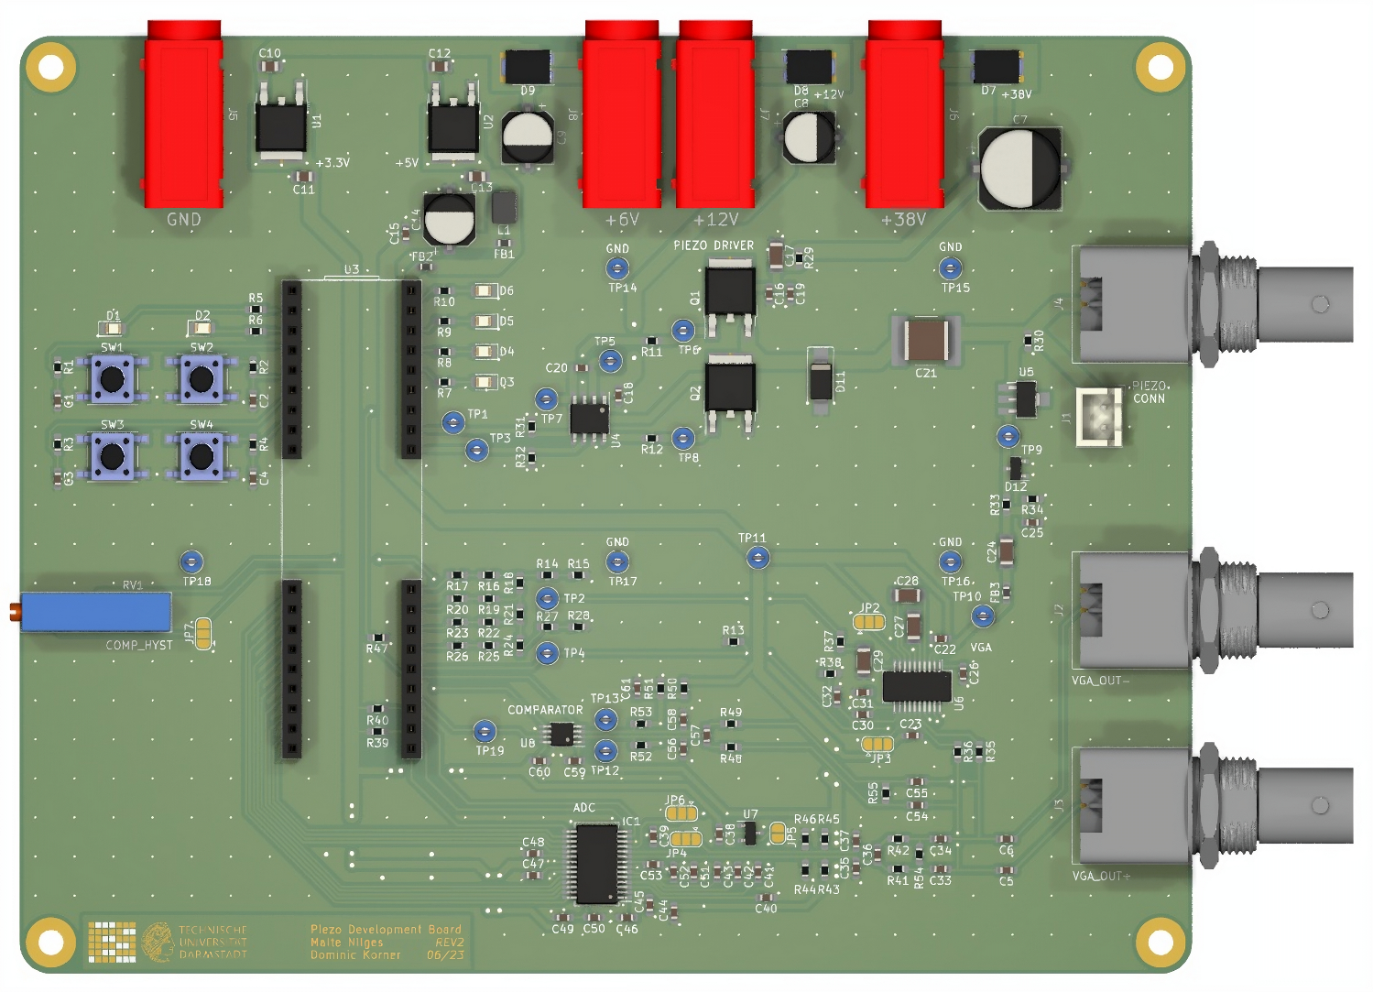
PCB DESIGN

Slide 5
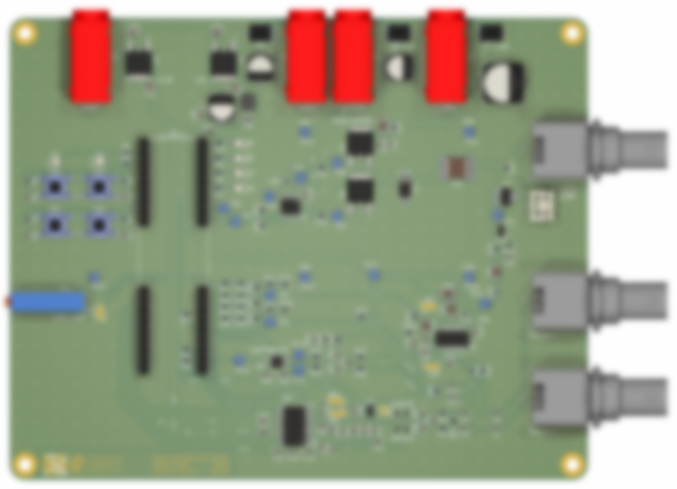

PCB DESIGN
Power stage:
Rails: 3.3V, 5VA, 5VD, 12V, 38V
NCP1117 3.3V & 5V LDO
3 connectors
Reverse polarity protection diodes

Slide 6

PCB DESIGN
FPGA & I/O:
CMOD S7 (Spartan XC7S25)
Push Buttons
LEDs
DAC

Slide 7

PCB DESIGN
Piezo driver stage:
MIC4604 half-bridge gate driver
2x FDD1600N10ALZ NMOS
TVS diode
AC-coupled output

Slide 8

PCB DESIGN
Piezo input & amplifier stage:
MD0100 T/R switch
BAV99 protection diodes
Filtering network
AD8331 Low-Noise Amplifier with Variable Gain Amplifier

Slide 9

PCB DESIGN
ADC stage:
AC-coupled
Low-pass filter network
MAX1426 10bit 10MHz ADC
Internal biasing; Vpp,diff = 4V

Slide 10
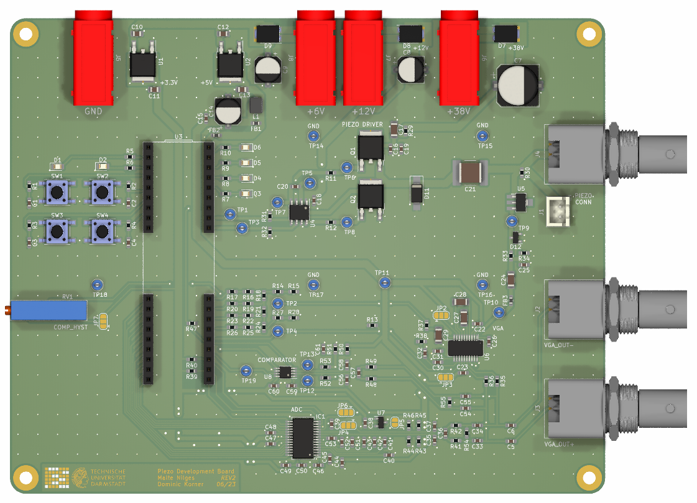

PCB DESIGN
Comparator stage:
AC-coupled
Band-pass filter network
LTC6752 280MHz comparator
External biasing
Adjustable hysteresis

Slide 11
FPGA MODULES
Main modules:
comm_protocol
vga_driver
comp_driver
adc_driver
Helper modules:
Imported modules:

Slide 12
FPGA MODULES
Main modules:
comm_protocol
vga_driver
comp_driver
adc_driver
Helper modules:
piezo_driver
delay
fifo_aggregate
fifo_x2byte
pulse_stretcher
serial_tx_handler
serial_rx_handler
buttons_handler
Imported modules:

Slide 13
FPGA MODULES
Main modules:
comm_protocol
vga_driver
comp_driver
adc_driver
Helper modules:
piezo_driver
serial_tx_handler
serial_rx_handler
Imported modules:
mmcme2_*
xpm_cdc_*
xpm_fifo_async
uart_tx
uart_rx

Slide 14
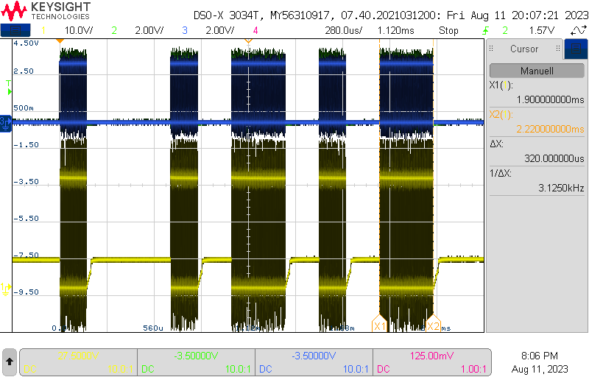
RESULTS – TRANsMISSION
Low-side and high-side output from FPGA
CHP
0L
1L
0L
1L
Half-bridge output to primary piezo
STL
BRL
BRL
BRL

Slide 15
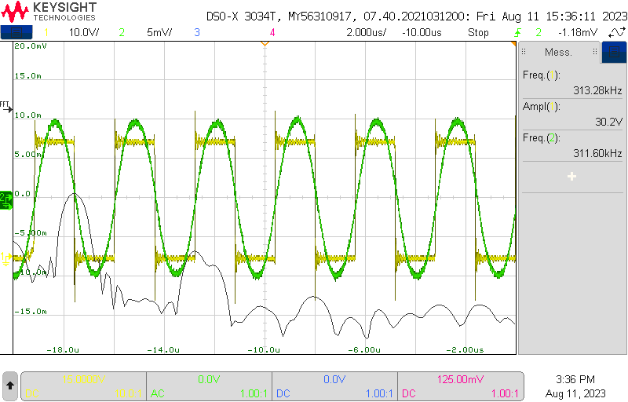
RESULTS – TRANsMISSION
Secondary piezo output
Half-bridge output to primary piezo

Slide 16
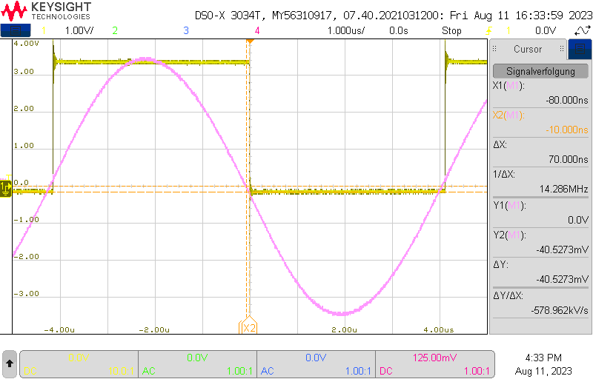
RESULTS – Comparator
Amplified differential input signal
Digital comparator output

Slide 17
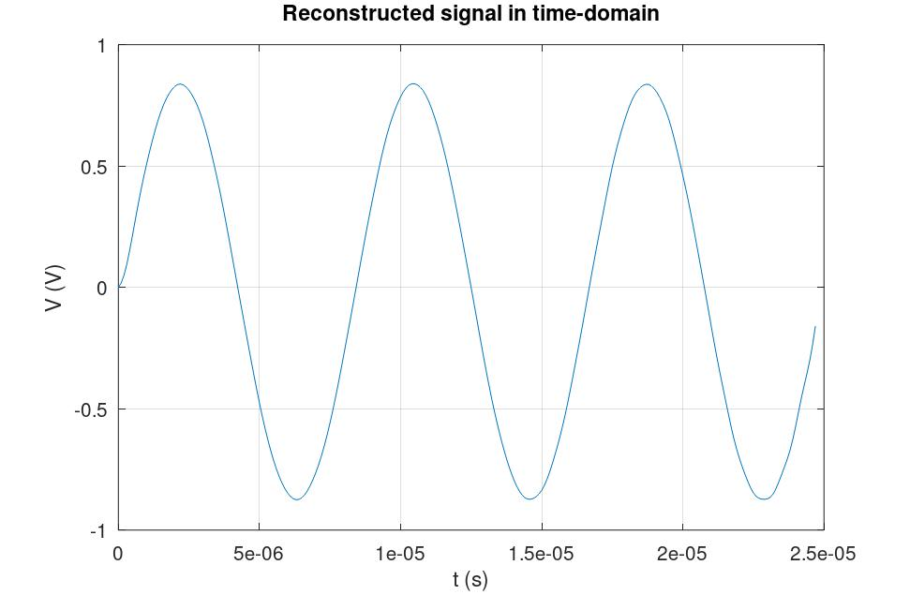
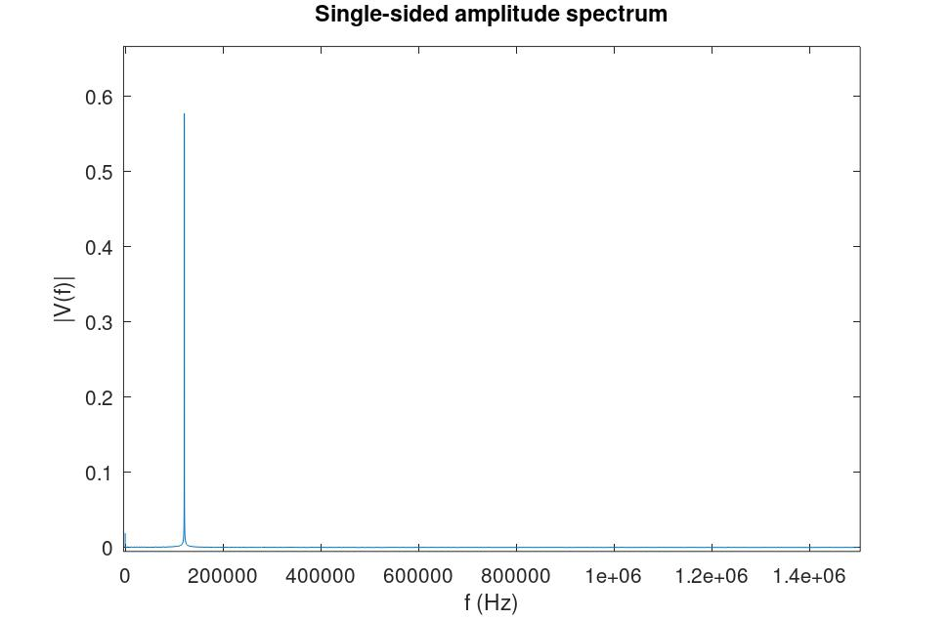
Results – adc

Slide 18
CONCLUSION
Hardware platform:
Drives piezo at specified loads (38 V, 100 Ω load, 2 MHz switching frequency)
Sampling of up to 5 MHz signals (ADC) or up to 25 MHz (comparator)
Software platform:
OOK transmission scheme
Variable sampling frequency and bit width
Possible improvements:
Increased host communication speed
Other transmission schemes

Slide 19
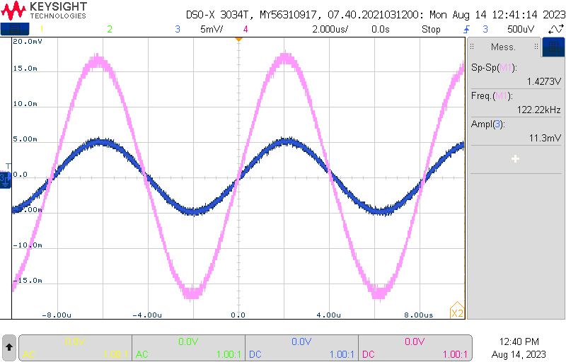
RESULTS – VGA
Amplified differential output signal
10 mV input signal

Slide 20
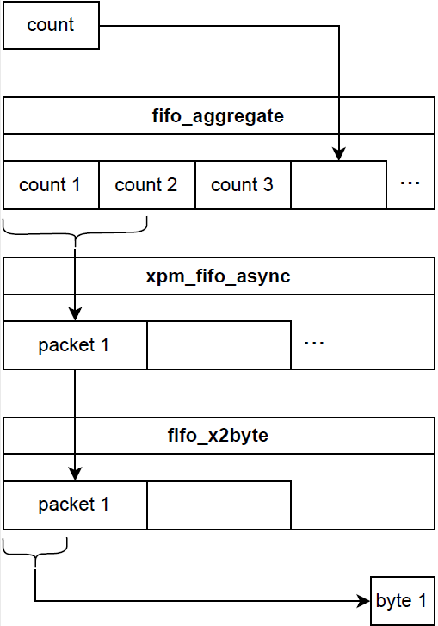
Fifo chain

